Slide 1





Slide 2

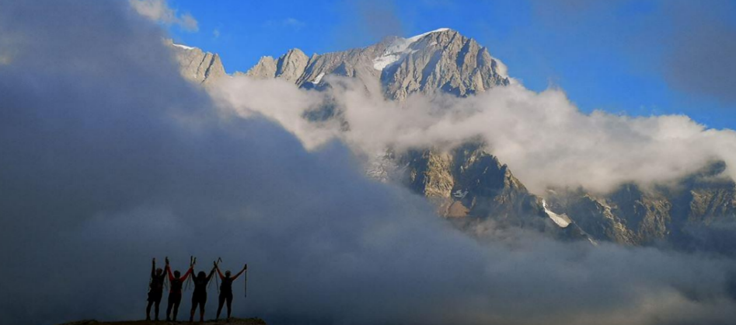


3 Countries. 3 peaks. 3 days. 3 Causes. 1 challenge
4 – 8 June 2025

Slide 3
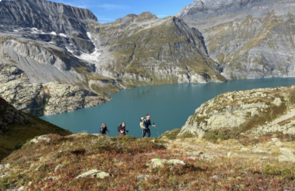
Join UA92 and CHX challenge for a unique & memorable event
Head to the iconic mountain town of Chamonix in the French Alps to enjoy a very special few days raising money for a great cause.
A chance to challenge yourself in the mountains, demonstrate your resilience, find your greatness and raise funds for UA92.
After each day, each peak, we return to an impressive Alpine chalet to enjoy a hot tub, a three-course meal and a glass of red.
Example itinerary:
Day 1: Arrive in Chamonix in the afternoon / evening in time for welcome drinks, dinner and overnight in a luxury chalet.
Day 2. 3 and 4: Breakfast in the chalet then head out to hike the peaks, forest paths, alpine pastures and open trials to the chosen peak each day.
After enjoying a picnic lunch on each summit, descent to Chamonix for a celebration drink and dinner in the chalet.
Over the 3 days we hike 3 peaks, 3 countries
All routes and summits are subject to weather conditions
and assessment of the group’s safety.
An example day……
8.00 am – Breakfast
9.00 – Depart chalet
9.15am – Hike starts
1.00pm – Lunch on the summit
4.45pm – Return to chalet
5.00pm – Hot tub / recovery / free time
7.00 – Dinner & drinks
9.00pm – Free time

Slide 4


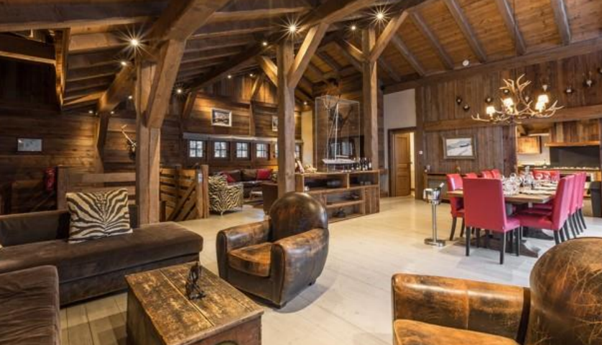

3 Countries. 3 peaks. 3 days. 3 Causes. 1 challenge.

Slide 5

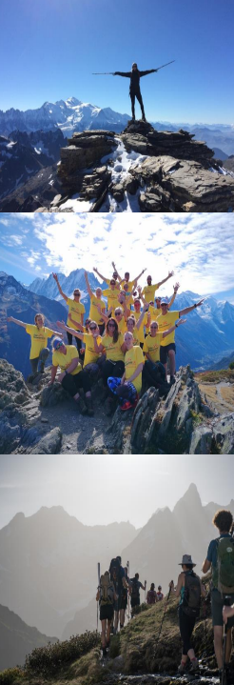



The details ……..
When: 4th June – 8th June 2025. (Challenge Thursday –Saturday)
Guides:
In addition to the experienced CHX staff, we also work with the very best guides from the Chamonix Valley. The guides will plan the routes. Ensure everyone’s safety at all times and teach you about the surrounding environment.
Accommodation:
You will stay in a luxury chalet in the Chamonix Valley. The chalet is the perfect place to relax after an exhausting day in the mountains, including a hot tub for tired legs. Our resident chef will provide a 3-course meal, catering for dietary preferences and requirements.
Logistics and Details:
Day pack to be carried by all participants
Picnic lunches provided plus breakfast and evening meal each day
Full kit list provided: warm clothing and good hiking boots required
CHX staff on hand to support you throughout
Included in the price of £1800: (20% deposit due early January 2025)
Twin or double room, single supplement available.
All guiding and hosting costs; luxury chalet accommodation; 2 meals per day prepared by private chef in the chalet as well as packed lunch. Wine and Beer in the chalet; in valley transport to and from the start point
Flights and transfers not included.
We would kindly ask that each participant raises a minimum of £5,000
Please contact CHX for further information or any questions:
Contact alison@chxchallenge.com / Robbie@chxchallenge.com or UA92 Jess.carney@ua92.ac.uk

Slide 6



Slide 7

Help us create CHANGE working together FOR BETTER
3 CAUSES
Bursary 92
Our community sports hub
Student mental health and wellbeing support

Slide 8



UA92 – SPONSORSHIP / CHARITY OPTIONS

